Slide 1
Server Monitoring
An overview of server processes and performance monitoring for resizing the infrastructure.

Slide 2
Introduction
This presentation covers the monitoring of twelve servers, with a focus on CPU usage, memory utilization, disk usage, and various processes. It also includes an analysis of Cron jobs running within these servers. Finally, the presentation provides a conclusion on whether server resizing is necessary based on the findings.

Slide 3
01
Server Overview

Slide 4
List of processes running on servers
App Servers:
MEGH_CANCARE
Nginx, Python
NHM-ANALYTICES
Nginx, Python
NHM-PAYMENT
Nginx, Python
NHM-SANGRAH
Nginx, Python
ECD
Nginx, Python
PROD-ASHPAY
Nginx, Python
DB Servers:
NHM-ASHAPAY_DB_1
Nginx, Python
Ashapay_h2_db_1
Nginx, Python
New_NHM_Payment_DB_1
Nginx, Python
NHM_Ecd_Db_1
Nginx, Python
NHM_Analytics _DB1
Nginx, Python
NHM_Sangarh_Db1
Nginx, Python

Slide 5
02
Processes

Slide 6
Docker process details
Docker is a containerization platform that enables the deployment and management of applications in isolated environments. On our servers, Docker containers are utilized to run various applications seamlessly, ensuring consistency across different stages of development and production.
Docker is a containerization platform that enables the deployment and management of applications in isolated environments. On our servers, Docker containers are utilized to run various applications seamlessly, ensuring consistency across different stages of development and production.

Slide 7
Cron jobs configuration
Cron jobs are scheduled tasks that automate repetitive actions on the servers. Each server is configured with specific cron jobs that handle tasks such as backups, system updates, and other routine maintenance operations, ensuring that processes run efficiently without manual intervention.
Cron jobs are scheduled tasks that automate repetitive actions on the servers. Each server is configured with specific cron jobs that handle tasks such as backups, system updates, and other routine maintenance operations, ensuring that processes run efficiently without manual intervention.

Slide 8
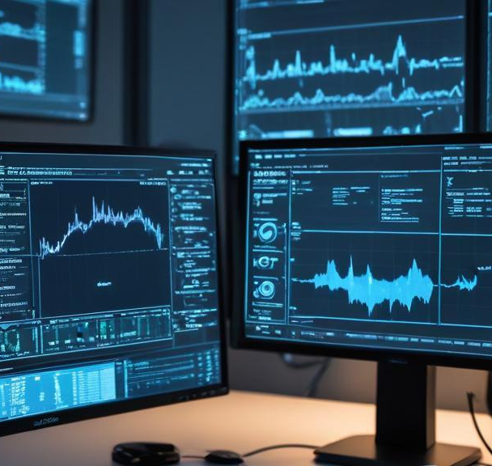
Performance impact of processes
The processes operating on our servers play a crucial role in overall performance. By utilizing monitoring solutions, we evaluate resource consumption, detect potential slowdowns, and enhance efficiency, ensuring that essential applications operate smoothly and reliably.

Slide 9

Conclusions
In summary, the systematic monitoring of our servers, with a focus on the processes they run, is vital for maintaining operational efficiency. Understanding the roles of Docker and cron jobs provides insights into their impact on performance and reliability.

Slide 10
Thank you!
Do you have any questions?
+91 620 421 838

